Slide 1
BRITISH AIRWAYS
Web scraping CUSTOMER REVIEWS to gain company insights

Slide 2
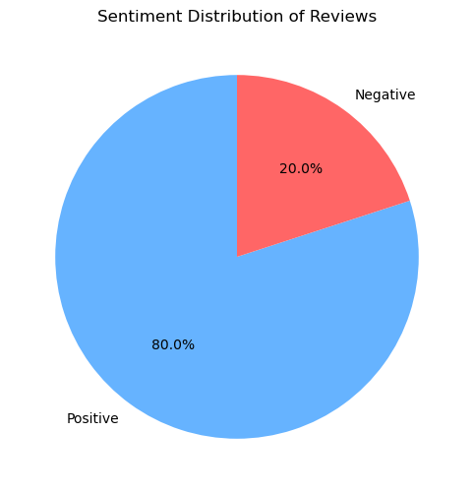
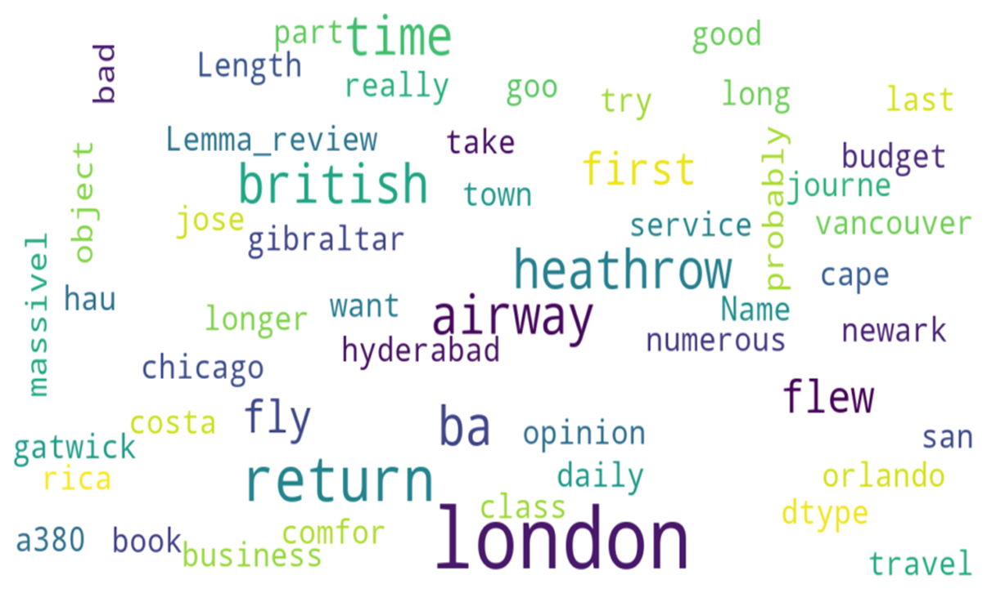
INSIGHTS GOTTEN FROM CUSTOMER REVIEWS

Slide 3
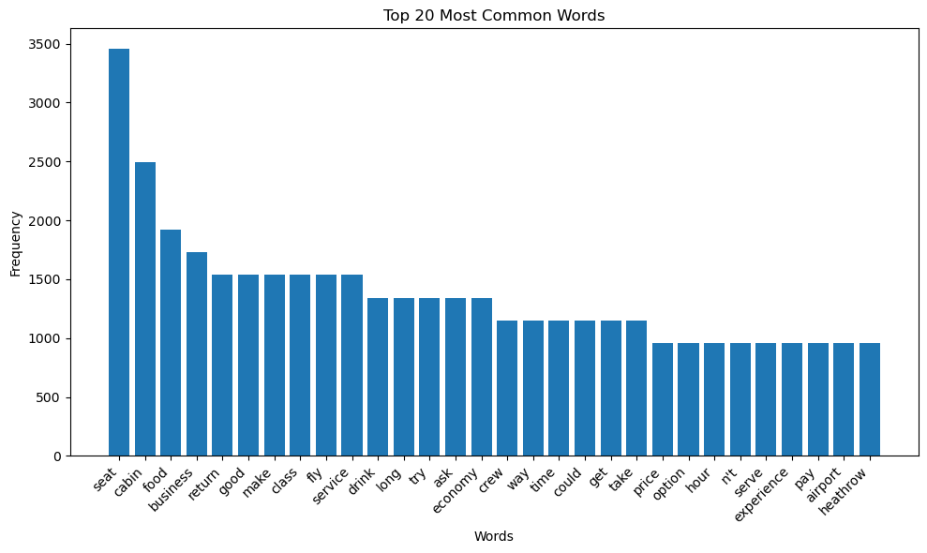
INSIGHTS GOTTEN FROM CUSTOMER REVIEWS

Slide 4
RECOMMENDATIONS
Focus On – customer services and comfort , like the Food, cabins and most importantly the seats.

